Slide 1

Eye Gaze Estimation through Webcam Technology
22MCA005 | 22MCA006 | 22MCA009
SAHIL ANTALA | MAIZ BAGWALA | BHUMIK RATHOD

Slide 2
Content
Introduction
Human-Computer Interaction
Eye Tracking Metrics and Visual Attention
Eye Gaze Estimation
Challenges in Eye Gaze Estimation
Algorithms for Eye Tracking
Role of Machine Learning in Eye Gaze Estimation
Ethical Considerations
Industry Adoption
Conclusion

Slide 3
Introduction
In this presentation we are going to discuss the signiﬁcance of accurate eye gaze estimation in human-computer interaction.
It explores the potential of webcam technology to enhance user experience.
This technology can be applied to various fields, from optimizing design and advertising to studying cognitive disorders and improving human-machine interfaces, ultimately enhancing user experiences and communication effectiveness.

Slide 4

Human-Computer Interaction
Human-Computer Interaction(HCI) is the study of how people interact with computers and to design technologies that let humans interact with computers in meaningful ways.
It encompasses user interface design, usability, and user experience.

Slide 5
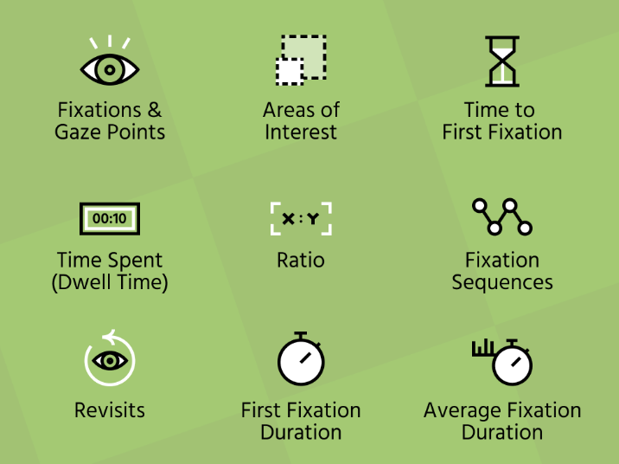
Eye Tracking Metrics and Visual Attention
Eye tracking metrics and visual attention analysis provide valuable insights into human behavior and cognition.
Fixation and eye movement metrics reveal where individuals focus their attention, while heat maps and gaze plots visualize attention patterns.

Slide 6
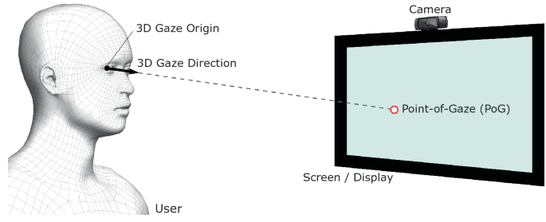
Eye Gaze Estimation
Eye gaze estimation is the process of determining the direction of a person's gaze.
It is crucial for understanding attention, intent, and emotions. Accurate eye gaze estimation can signiﬁcantly improve user engagement and interaction.

Slide 7
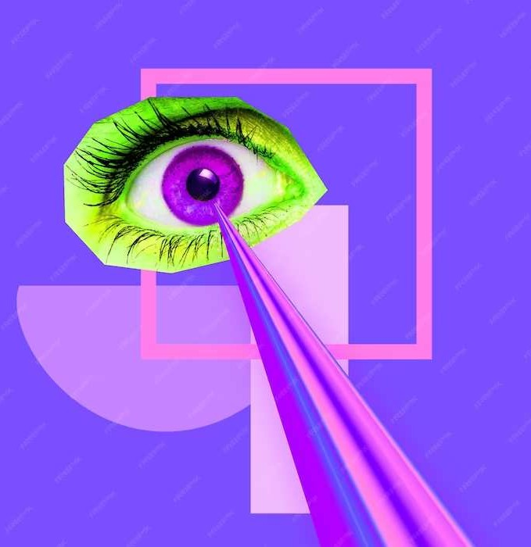
Challenges in Eye Gaze Estimation
Challenges in eye gaze estimation include:
Head Movement,
Lighting Conditions.
Overcoming these challenges is essential for achieving high accuracy in eye gaze estimation.

Slide 8
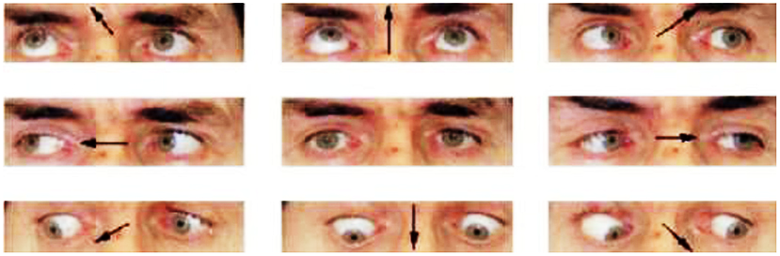
Algorithms for Eye Tracking
Developing robust algorithms is essential for accurate eye tracking.
Techniques such as pupil tracking, corneal reﬂection analysis, and machine learning are employed to estimate gaze direction.

Slide 9
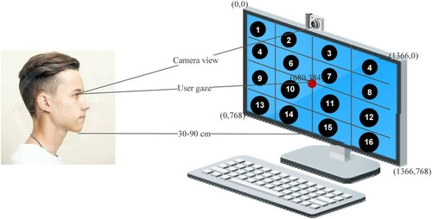
Role of Machine Learning in Eye Gaze Estimation
Machine learning techniques like convolutional neural networks and deep learning are used for eye gaze estimation.
These techniques are becoming more popular in this context.
The system employing these techniques can learn and adapt to individual differences.
It can also adapt to environmental factors affecting gaze estimation.
The use of these techniques enhances the accuracy and effectiveness of eye gaze estimation systems.

Slide 10
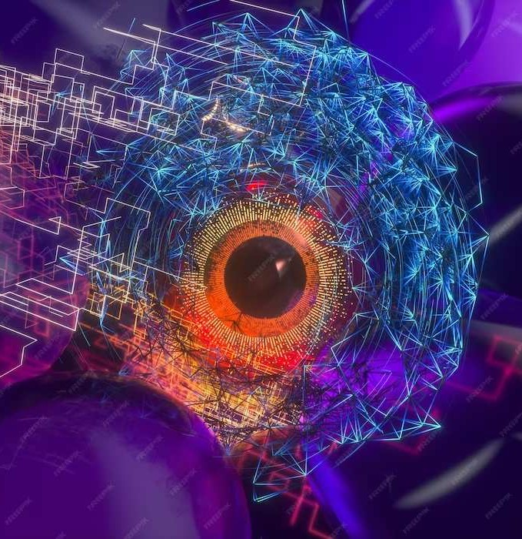
Ethical Considerations
Accurate eye gaze estimation raises ethical considerations related to privacy, data security, and informed consent.
It is crucial to address these concerns to ensure responsible and ethical use of gaze tracking technology.

Slide 11
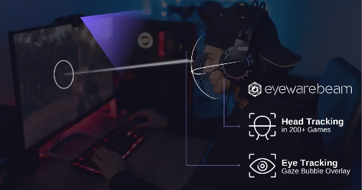
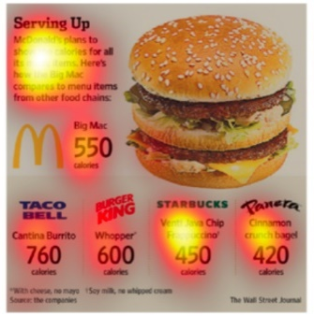
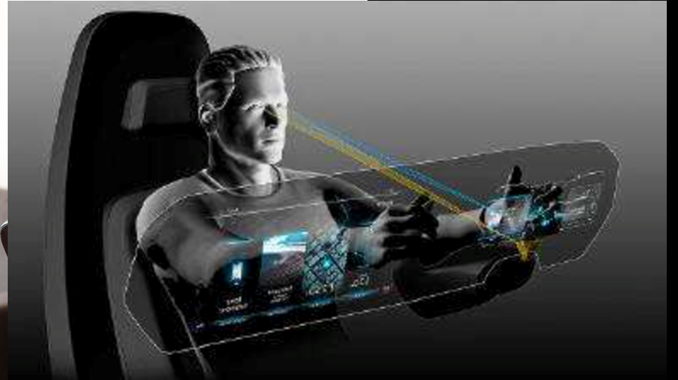
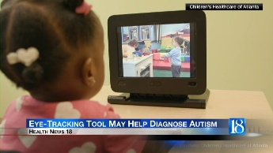
Industry Adoption
Various industries are increasingly adopting accurate eye gaze estimation to enhance user experience, product design, and marketing strategies.
Some of them are as follows:
Gaming,
Automotive,
Healthcare, and
Advertising.

Slide 12
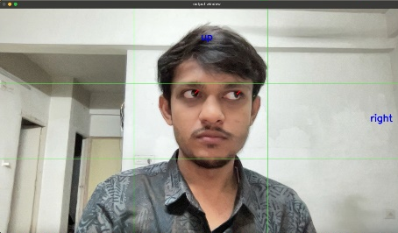
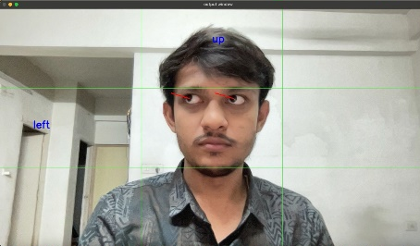
Implementation Process
Firstly, We Imported the Open CV Library.
Then, We Captured our face through Webcam.
After that, We Used mediapipe(Google Library).
In mediapipe, We Used facemap which Generates face landmark coordinates.
Then we took, a coordinate of the Iris.
Also, the coordinates of Pupil are taken into consideration.
Then, We applied the Gaze Detection Algorithm.
Which Helped us in Getting the exact point at which the eye is gazing as well as the gaze time.

Slide 13
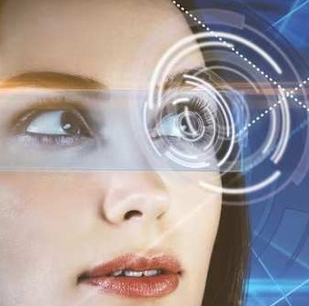
Conclusion
In conclusion, accurate eye gaze estimation through webcam technology holds immense potential to revolutionize human- computer interaction. It offers opportunities for personalized experiences, enhanced accessibility, and innovative applications across various industries.

Slide 14
Thank You
22MCA005 | 22MCA006 | 22MCA009
SAHIL ANTALA | MAIZ BAGWALA | BHUMIK RATHOD

